Slide 1

AI Driven Personalized Study Plan Generator
by
Sai Sreeja S
Roll No. 214G1A3294
Pranathi G
Roll No. 214G1A3276
Sree Nithya G
Roll No. 214G1A32A1
Sai Rithvik Reddy C
Roll No. 214G1A3293
Under the guidance of
Dr. B. Harichandana _{M. Tech., Ph.D.}
Associate Professor
Department of Computer Science and Engineering (Data Science)
Srinivasa Ramanujan Institute of Technology
(Affiliated to JNTUA & Approved by AICTE) (Accredited by NAAC with ‘A’ Grade & Accredited by NBA (EEE, ECE & CSE)
Rotarypuram Village, B K Samudram Mandal, Ananthapuramu – 515701.
2024 - 2025

Slide 2
Review-0 Queries
Change the title
Take comparision on techniques

Slide 3

Contents
Abstract
Problem Statement
Objectives of Project
Literature survey for first objective
Literature survey for Second objective
Proposed Work
Introduction
Existing Sysytem

Slide 4
Cont…
Proposed System
Planning
Requirements
UML Diagarms
Data Flow diagram
Data Preprocessing Technique
Sample Code
References
GitHub Link

Slide 5
Cont…
Screenshots
Project Execution
References
GitHub Link

Slide 6
Abstract
The rapid integration of Machine Learning (ML) in education has highlighted several critical gaps, particularly in data privacy, scalability and ethical concerns regarding data use. These challenges can be overcomed by the following solutions to enhance AI-driven personalized learning systems. To address data privacy, federated learning are recommended. Scalability concerns can be mitigated through distributed learning frameworks, and edge AI, ensuring systems can efficiently handle large numbers of students. Real-time adaptation is achieved by integrating reinforcement learning, streaming data analytics, and AI agents that dynamically adjust learning pathways based on immediate feedback. The proposed solutions collectively aim to build a scalable, adaptable, and ethical AI-powered educational system that prioritizes student privacy, fairness, and performance.
Keywords: Reinforcement Learning, Progress Tracking, Recommendation System

Slide 7
Problem Statement
In the modern education landscape learners often face challenges in creating effective, personalized study plans tailored to their unique needs, goals and learning styles. Traditional study plans lack adaptability, fail to account for individual strengths and weaknesses and do not incorporate real-time feedback or evolving priorities. This can result in inefficient time management, suboptimal learning outcomes and reduced motivation. The absence of an intelligent system capable of analyzing a learner's preferences, performance data and time constraints further exacerbates the issue leaving students unable to achieve their full potential.

Slide 8
Objectives Of Project
To build an AI-driven personalized study plan generator leveraging machine learning techniques to create tailored study schedules based on individual user profiles, including goals, strengths, weaknesses, and learning preferences.
To dynamically adapt study plans in real-time by analyzing user performance, progress, and feedback, ensuring continuous optimization and alignment with the learner’s evolving needs and priorities.

Slide 9
Literature Survey for First Objective
TITLE | AUTHORS | METHODOLOGY | LIMITATIONS
Adaptive Learning Systems: A Literature Review | A. Brusilovsky et al. | Explored adaptive learning systems using user profiles and machine learning for personalized content delivery. | Limited focus on integrating real-time user feedback for dynamic updates in study plans.
AI-Powered Educational Recommender Systems | S. Hwang et al. | Implemented AI-based recommendation engines to suggest learning materials tailored to user preferences. | Emphasis was on content recommendations rather than comprehensive study schedule generation.

Slide 10
Literature Survey for Second Objective
TITLE | AUTHORS | METHODOLOGY | LIMITATIONS
Dynamic Student Profiling for Adaptive Learning | J. B. Black et al. | Utilized machine learning models to track and adapt study plans based on real-time performance data. | Focused primarily on academic contexts, limiting applicability to diverse learning environments.
Personalized Learning Using Reinforcement Learning | K. Wang et al. | Applied reinforcement learning to personalize and update study plans dynamically with performance feedback. | High computational complexity and limited scalability for large datasets or diverse user profiles.

Slide 11
Proposed Work
Methods to be Followed:
User Input Analysis: Use input features like preferences, performance, and goals to initialize the study plan.
Plan Optimization: Employ reinforcement learning to update plans dynamically based on user feedback.
Material Ranking: Implement ML algorithms to rank and recommend study materials.
Performance Analysis: Use statistical methods and ML models to evaluate user progress and adjust the plan accordingly.

Slide 12
Introduction
Importance of personalized study schedules over generic ones.
The role of reinforcement learning in tailoring adaptive plans.
Challenges in addressing individual performance variations.
Integration of user preferences and data-driven insights.
Real-time tracking and dynamic updating of study plans.

Slide 13
Cont..,
Application of AI to improve learning outcomes.
Benefits: Enhanced engagement, goal alignment, and time management

Slide 14
Existing System
Relies on static, one-size-fits-all study plans.
Lacks dynamic updates based on individual performance.
Minimal use of ML techniques for personalized learning.

Slide 15
Proposed System
Data Collection: Gathering inputs on user preferences, performance, and goals.
User Profiling: Creating detailed profiles for individual learning needs.
AI Integration: Employing machine learning to personalize schedules.
Reinforcement Learning: Real-time adaptation based on user progress.
Dynamic Adjustments: Modifying plans dynamically based on new inputs.

Slide 16
Cont..,
Performance Metrics: Evaluating user performance to refine recommendations.
Recommendation Engine: Suggesting resources to address weak areas.
Time Management: Incorporating breaks and task prioritization.
Late Submission Penalties: Adjusting plans based on submission behavior.
Outcome Tracking: Monitoring progress towards set goals.

Slide 17
Cont..,
User Feedback Integration: Refining plans with iterative improvements.
Ethical Safeguards: Addressing data privacy and algorithmic bias concerns.

Slide 18
Planning
January 2025: Finalize requirements, system design, and data preprocessing techniques.
February 2025: Develop core modules (User Input Analysis, Plan Generator).
March 2025: Integrate all modules, refine algorithms, and conduct initial testing.
April 2025: Perform final testing, deploy the system, and prepare documentation.

Slide 19
Requirements
Functional Requirements:
Collect user data (preferences, goals, performance metrics).
Generate and dynamically update study plans.
Provide study material recommendations.
Track and analyze user progress.
Non-Functional Requirements:
Scalability for handling multiple users.
High system availability and reliability.
Secure data storage and processing.
Responsive user interface.

Slide 20
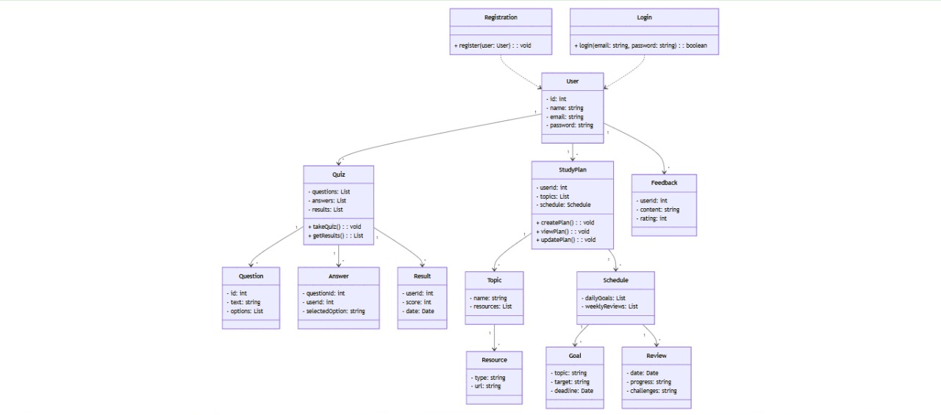
UML Diagram
UML Diagram (Class Diagram) :-

Slide 21
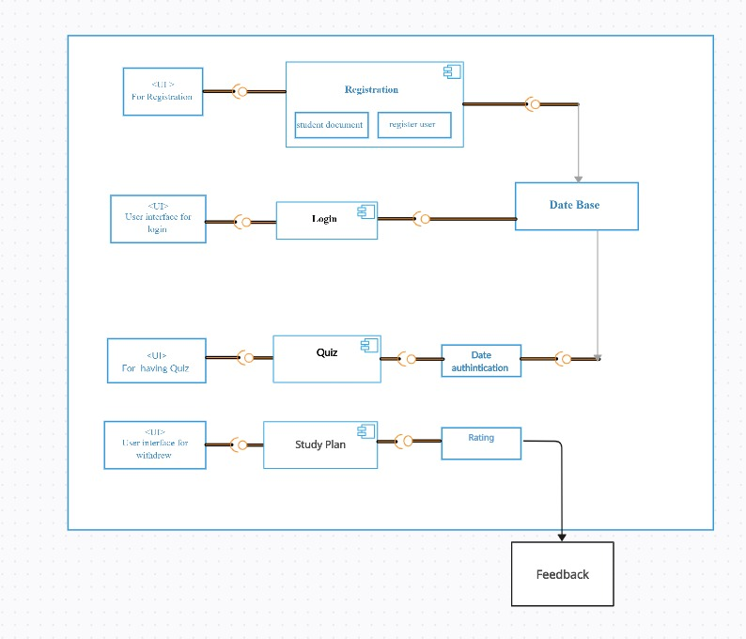
UML Diagram
Deployment Diagram :-

Slide 22
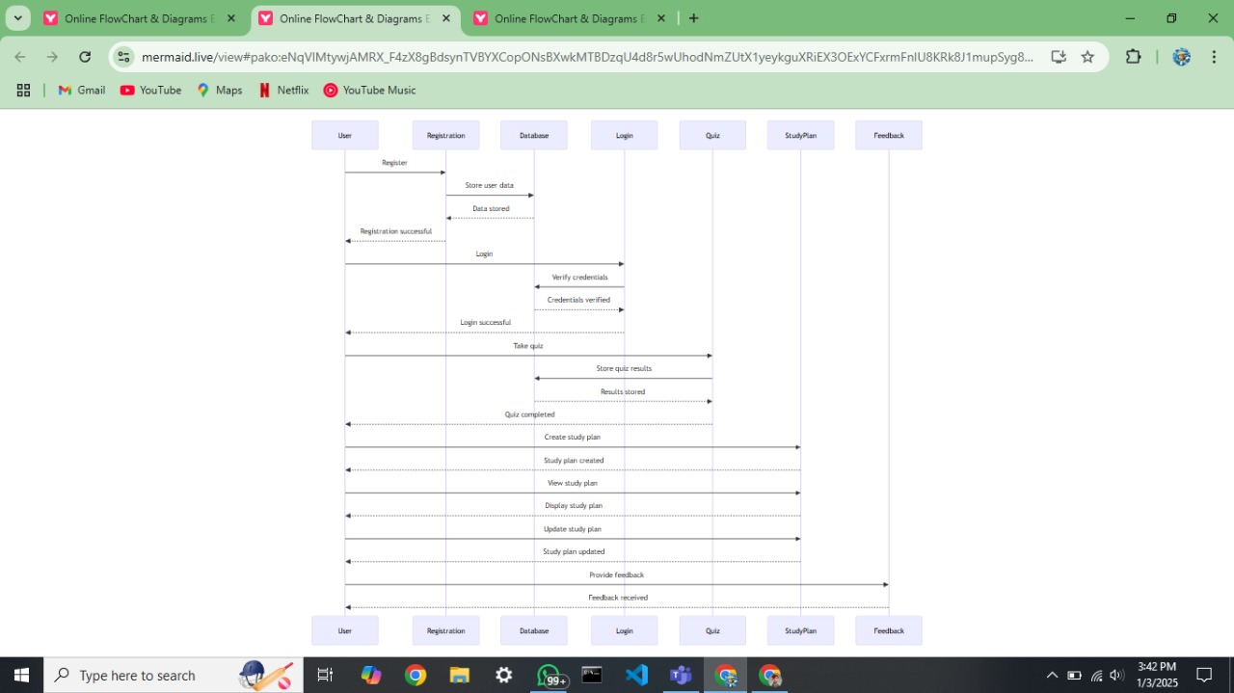
UML Diagram
Sequence Diagram :-

Slide 23
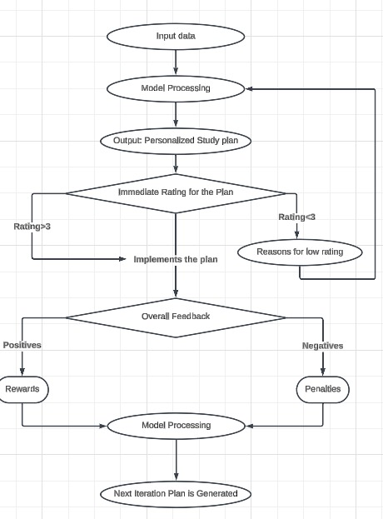
Data Flow Diagram
Data Flow Diagram

Slide 24
Data Preprocessing Techniques
Handling Missing Data: Filling in missing user inputs using default values or averages.
Data Normalization: Scaling inputs (e.g., time, goals) for uniformity.
Feature Encoding: Converting categorical data (e.g., preferences) into numerical values.
Noise Removal: Eliminating irrelevant or incorrect entries from datasets.

Slide 25
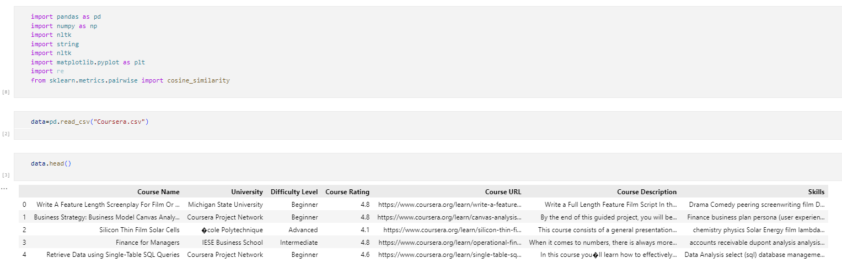
Sample Code
Importing Libraries and Gathering Data

Slide 26
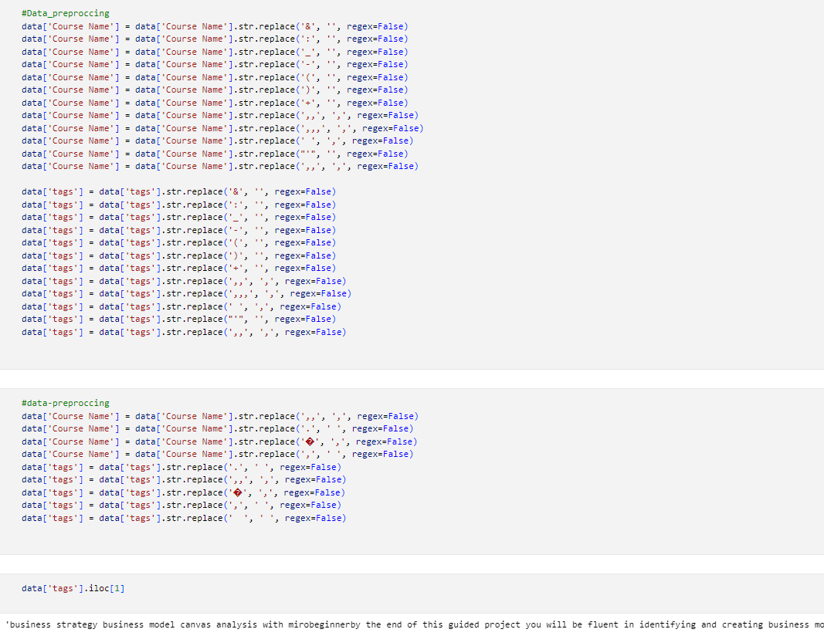
Sample Code
Data Preprocessing using NLP

Slide 27
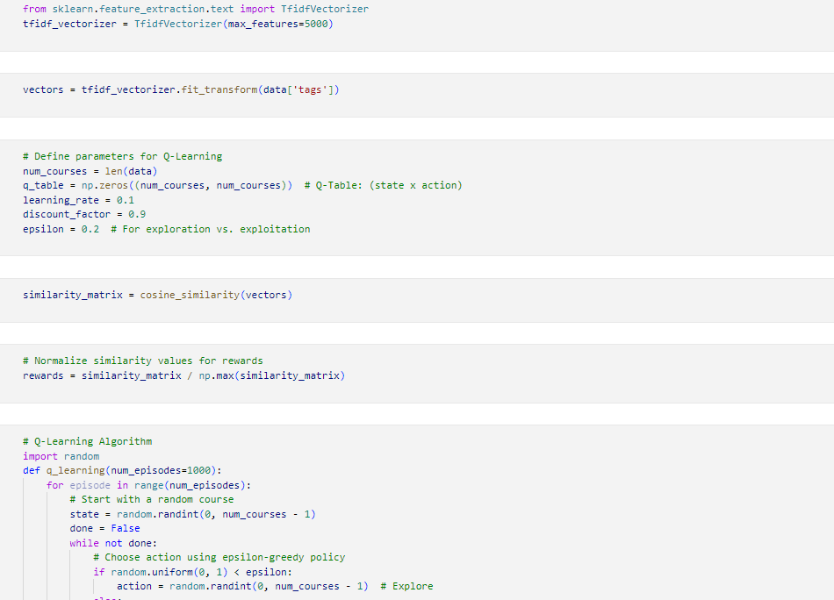
Sample Code
TF-IDF and Q-Learning Algorithms

Slide 28
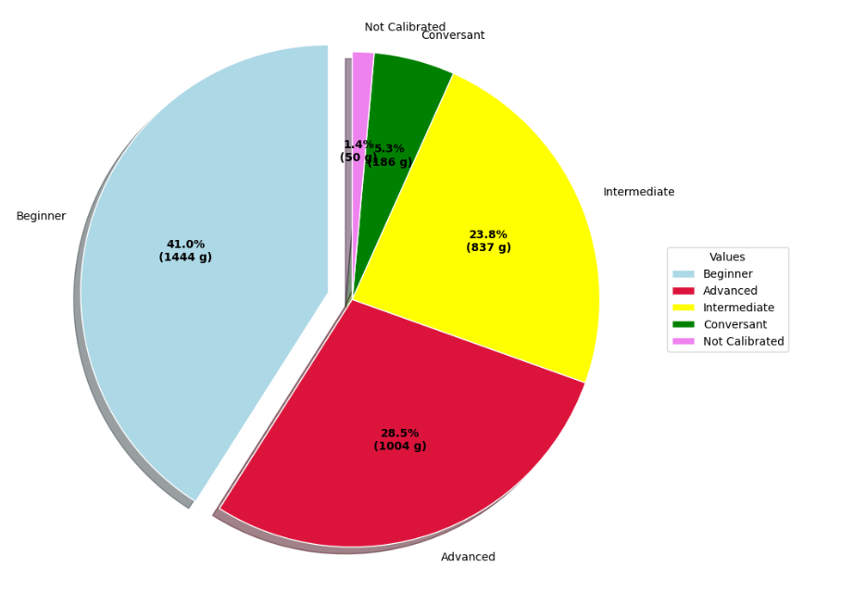
Screenshots
Pir Chart of Courses vs User Caliber

Slide 29
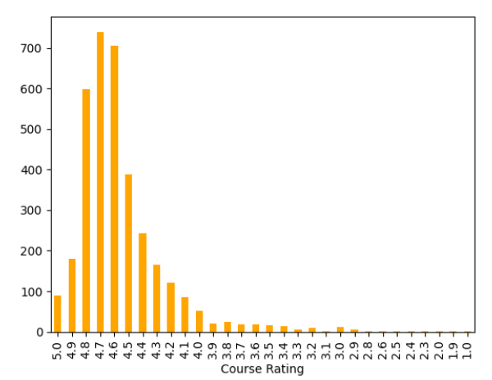
Screenshots
Course Rating Graph

Slide 30
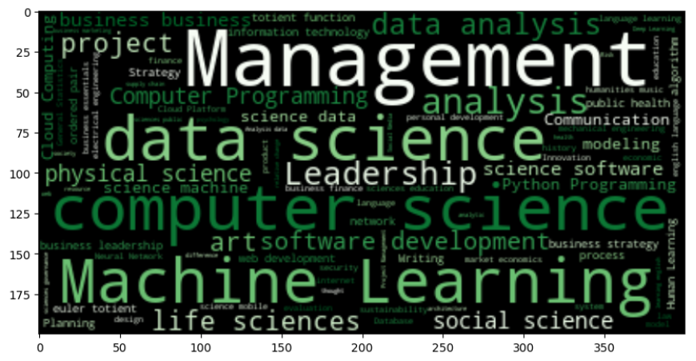
Screenshots
Word Cloud of Skills

Slide 31
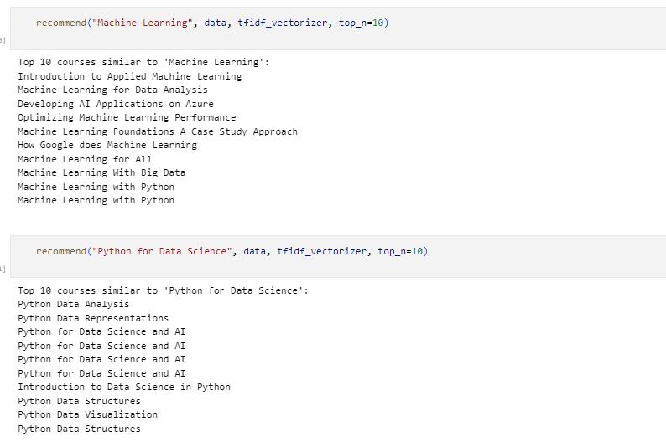
Project Execution
Relevant Courses Recommendations

Slide 32
Reference
[1]. M. Sharif, Multi-Modal Learning Analytics in Personalized Education Using Deep Reinforcement Learning, IEEE Access, 2024.
[2]. S. Amin, M. I. Uddin, et al., Smart E-Learning Framework for Personalized Adaptive Learning, IEEE Access, 2023.
[3]. R. Patel et al., AI-Driven Personalized Learning Plan, USRD, 2023.
[4]. M. Murtaza, Y. Ahmed, et al., AI-Based Personalized E-Learning Systems, IEEE Access, 2022.

Slide 33
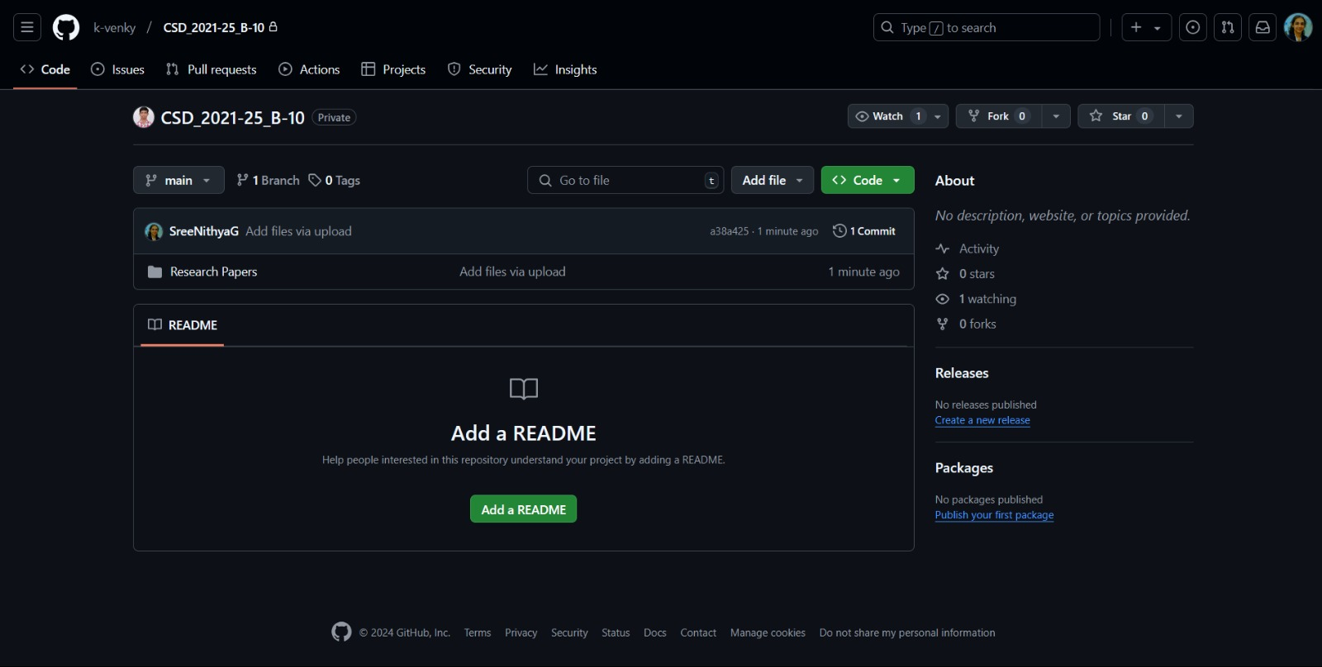

Git Hub Dashboards of each student

Slide 34
Any Queries?

Slide 35
Thank You!!!

